Slide 1
Category A - Loadbalancing
Xavier Geerinck
Joey Comhaire

Slide 2
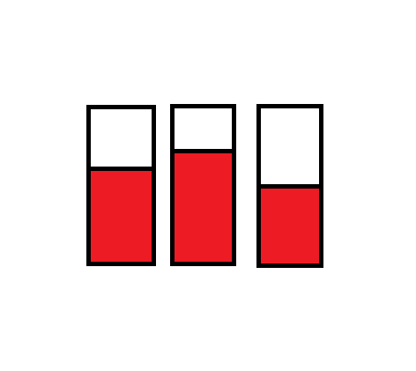
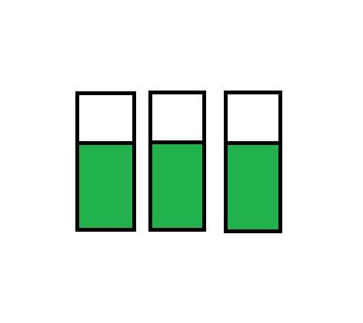
Loadbalancing
Loadbalancing is used to reduce the load on servers
Servers + overload = slower
Loadbalancer ➔ divide the load

Slide 3
Loadbalancing
Commonly used in game technology
Divide clients over servers
Or specific task on each server

Slide 4
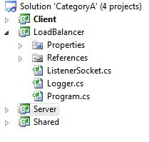
Tutorial
See tutorial of sockets (Category C)
LoadBalancer
Logger (same as Server and client)
ListenerSocket
Program (starts listener Socket)
Listens to clients
Search right server
Connect client with server

Slide 5
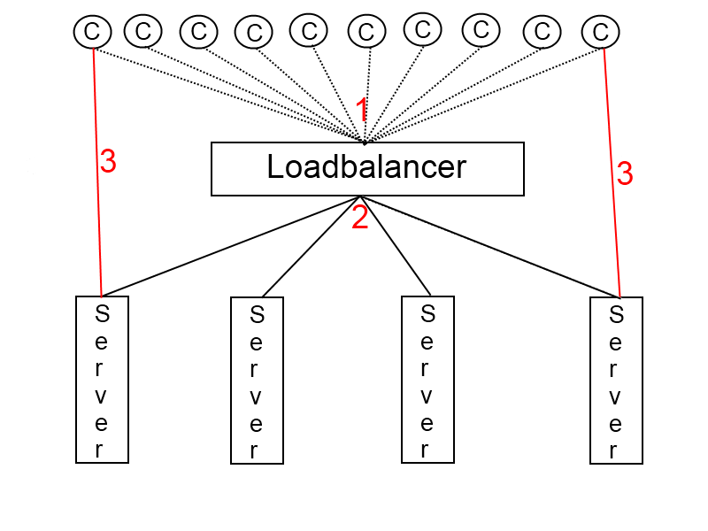

Slide 6
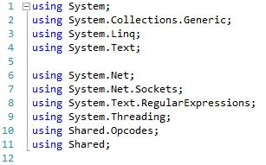
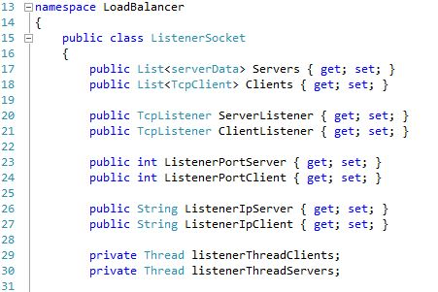
Tutorial - ListenerSocket
List with Servers
List with Clients
ServerListener and ClientListener
Server and client port to listen to
Server and client ip connected to
Server and client Thread work with
and listen to incoming or outgoing
data

Slide 7
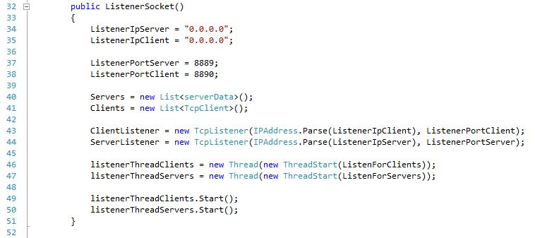

Tutorial - constructor
Default Ip’s
Default Ports
List of new Servers(inner class serverData)
List of new clients
Makes new Listener for Clients and Servers
Makes new threads for Clients and Servers
Start the threads
Fucntions

Slide 8
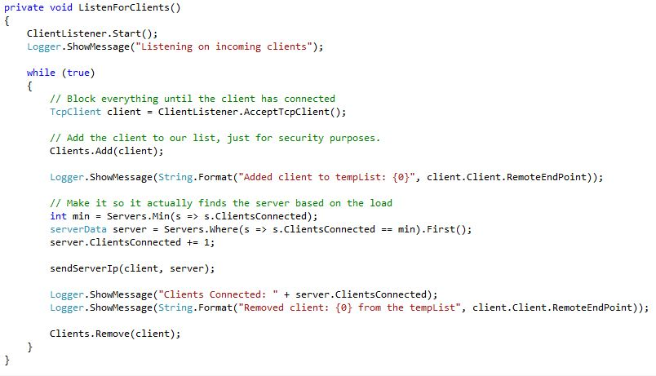
Tutorial - ListenForClients
Show Message in Logger
Keeps running
Accepts client on the
previous made listener
Add the client to the list
Finds the least loaded
server and sets the
Clientsconnected attribute
Method

Slide 9
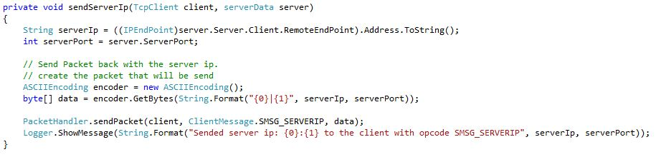
Tutorial - SendServerIp
Gets serverport and serverIp
Encodes the message
Handles the packet

Slide 10
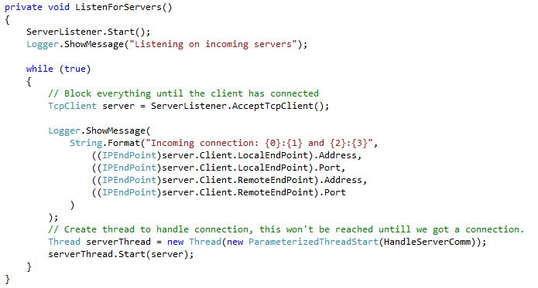
Tutorial – ListenForServers
Starts listening to servers
and show message
Keeps running
Accepts server on the
previous made listener
Shows message in
Logger about which
Client connected to
Which Server
Makes new thread and starts it
function

Slide 11
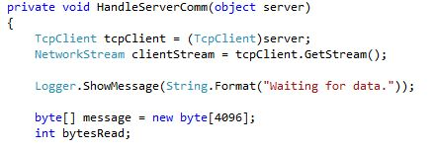
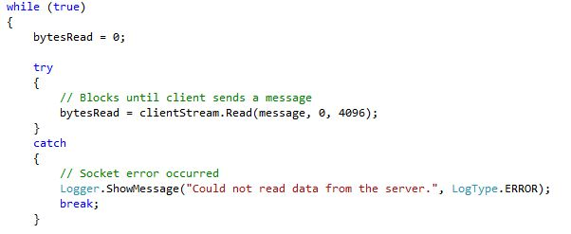
Tutorial - HandleServerComm
Makes server and opens
A stream (to send the data)
with it
message
Sends message over stream

Slide 12
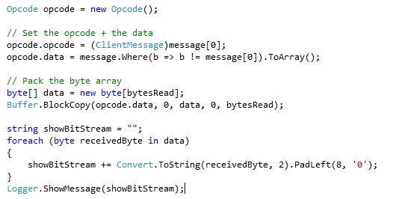
Tutorial – HandleServerComm
Makes a typical message (opcode + data)
Shows the opcode message in 0’s and 1’s

Slide 13
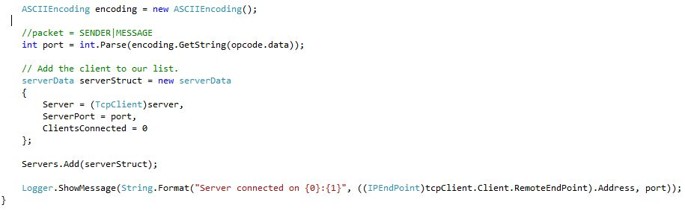
Tutorial - handleServercomm
Struct with the needed data
Add data to server list

Slide 14
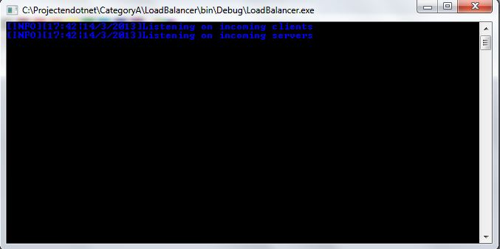
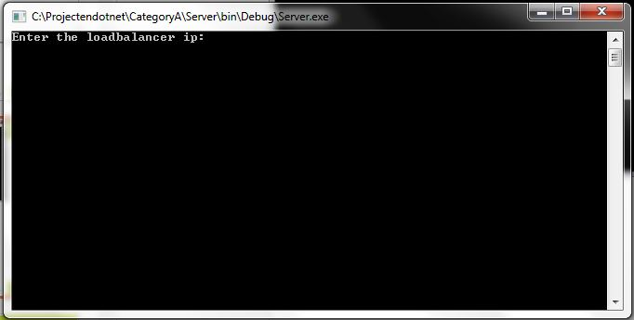
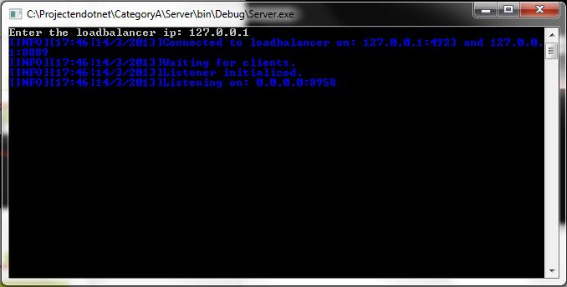
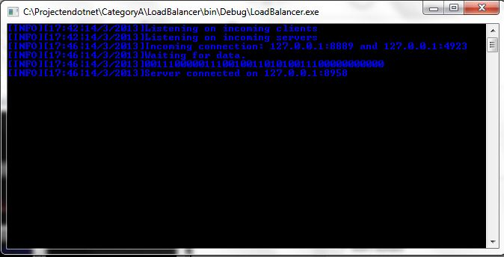
Loadblancer
Server (not connected)
Server (connected)
Loadblancer (1 server connected)

Slide 15
Tutorial
Loadblancer (1 client connected to server)

Slide 16
Conclusion

Slide 17
Conclusion
Loadbalancer are used to divide the work for the servers
Based on internet connections and sockets

Slide 18
Sources

Slide 19
http://nl.wikipedia.org/wiki/Load_balancing
http://www.codeproject.com/Articles/3338/NET-Dynamic-Software-Load-Balancing
http://msdn.microsoft.com/en-us/library/ms730128.aspx

